Slide 1
Tree Testing
Shih Hung Lin

Slide 2
10 Tasks
1. You want to check if novel Jurassic Park is available in the library
2. You want to request a digital download of UX for Lean Startups
3. You want to apply a library card
4. You want to ask for an online 1on 1 homework help
5. You want to check new arrived books

Slide 3
10 Tasks
6. You want to find some interesting events held on the weekend
7. You want to borrow a laptop from a library
8. You want to enroll an online high school program
9. You want to check which library we can find a study room
10. You want to find a job in a library

Slide 4
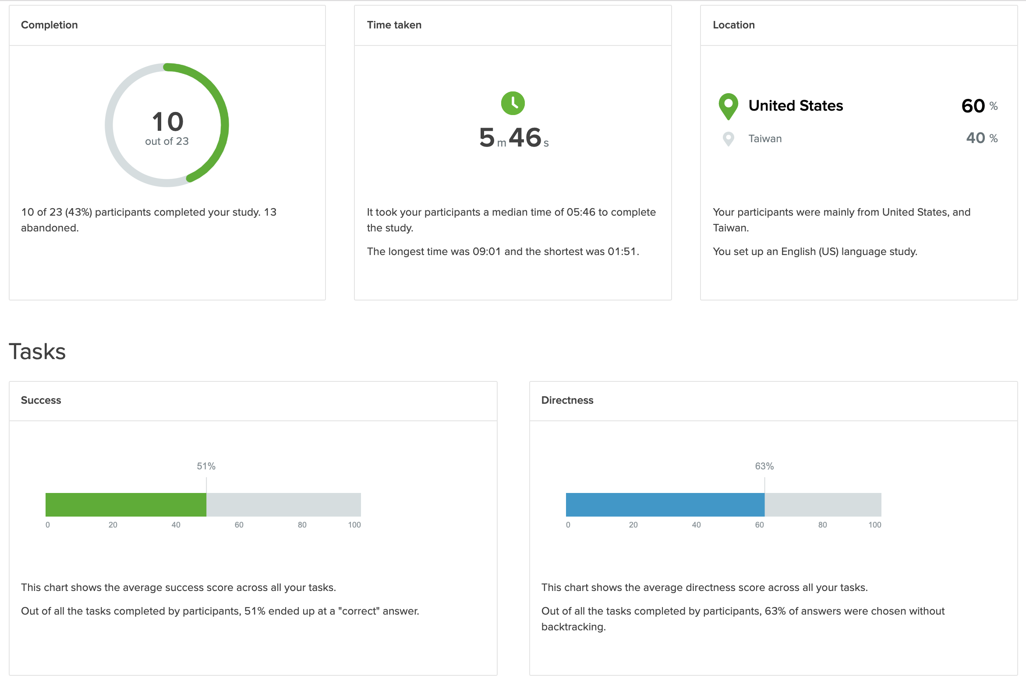

Slide 5
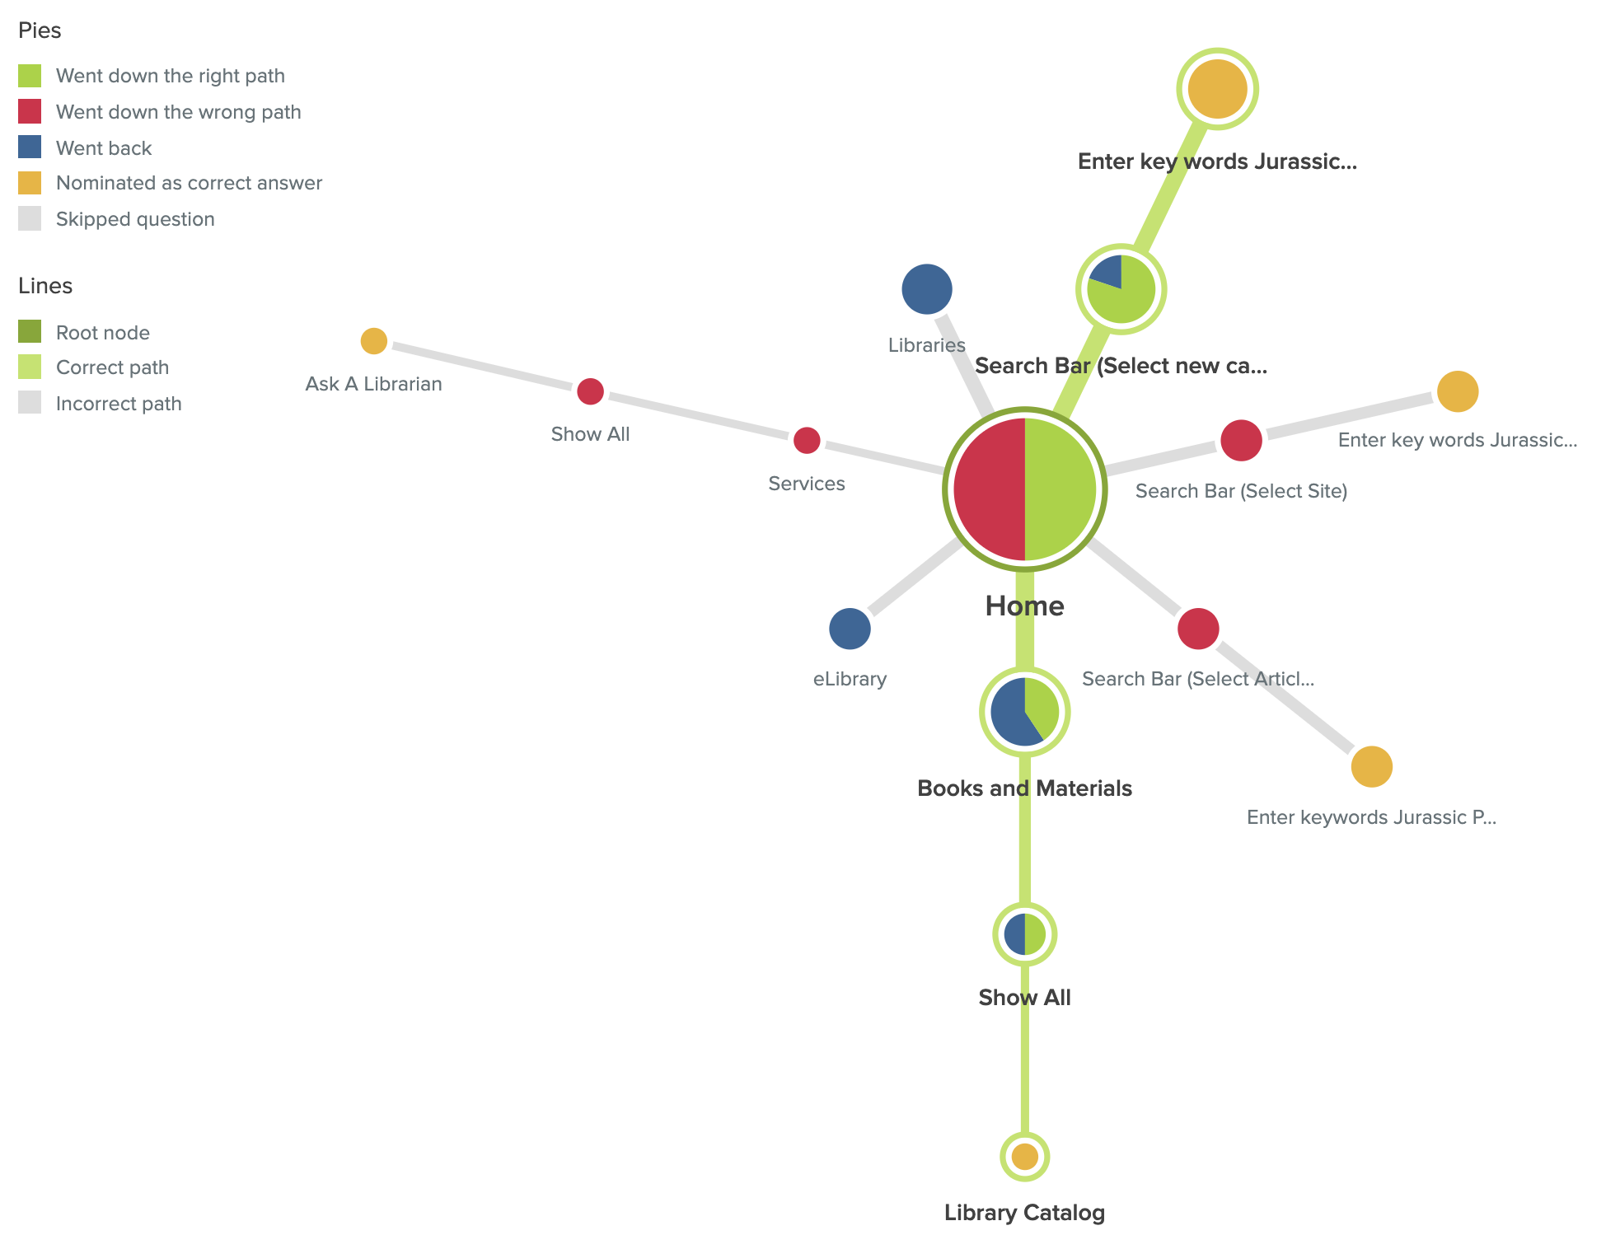
1.You want to check if novel Jurassic Park is available in the library

Slide 6
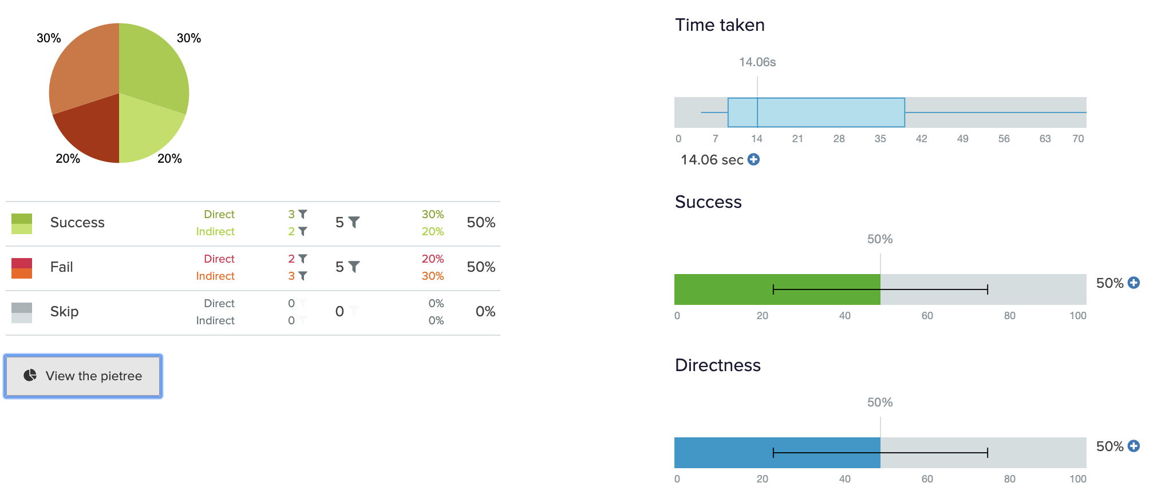
1.You want to check if novel Jurassic Park is available in the library

Slide 7
1.You want to check if novel Jurassic Park is available in the library
Potential pain points:
The label eLibrary and libraries confuse people.
Search Bar has three different types(catalog, site, articles and databases), actually they can only find book in the calalog.
Insights:
Some people will ask the librarian directly.

Slide 8
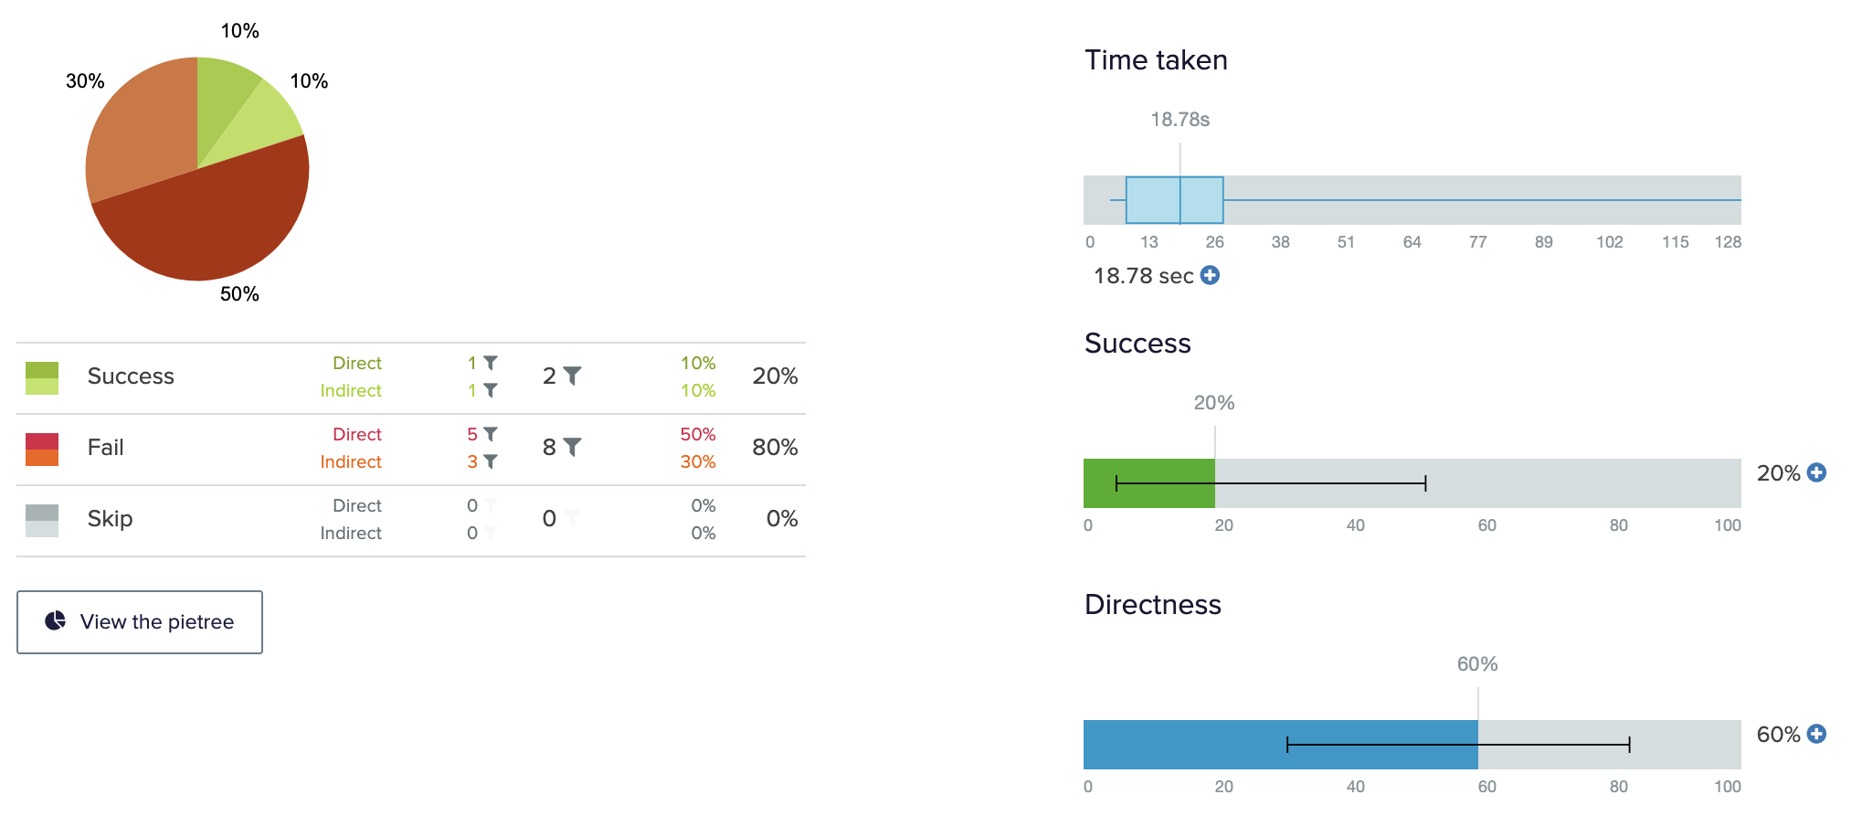
2.You want to request a digital download of UX for Lean Startups

Slide 9
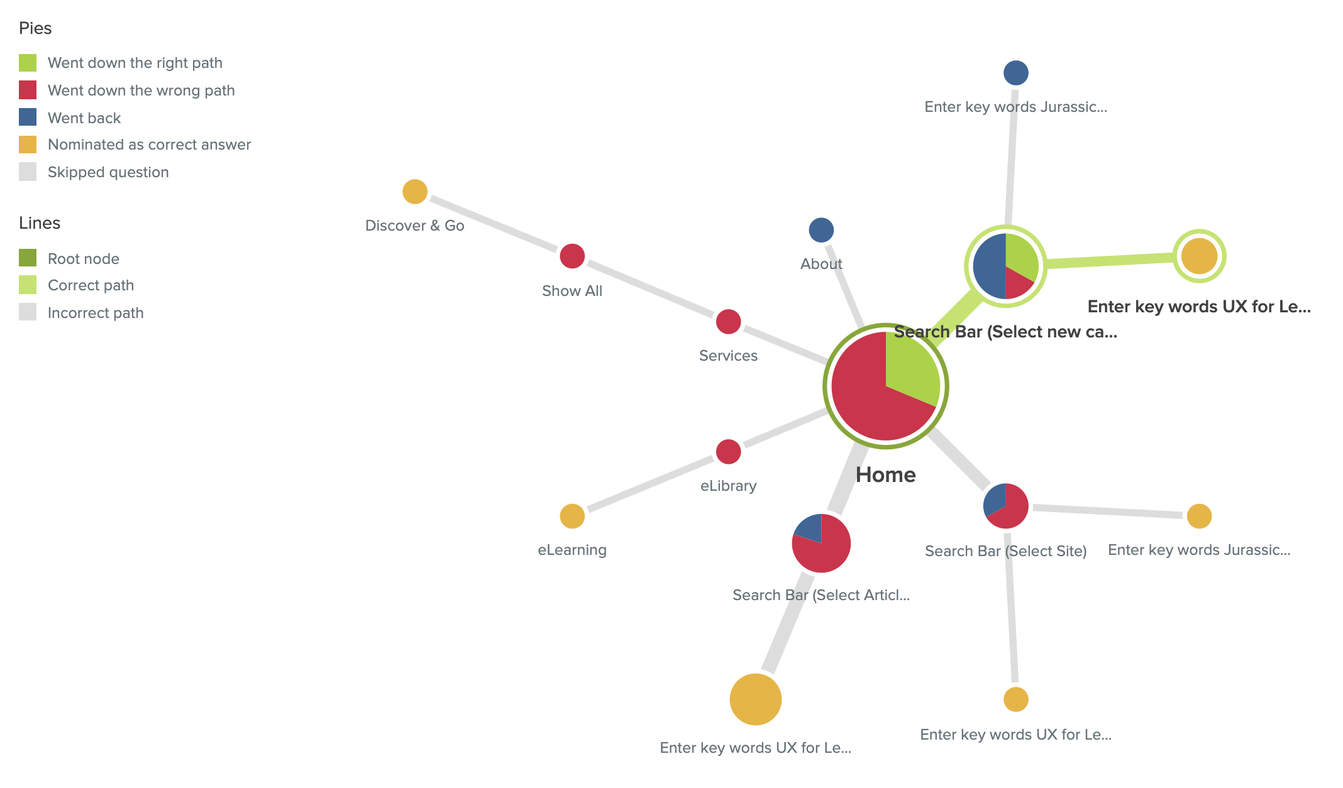
2.You want to request a digital download of UX for Lean Startups

Slide 10
2.You want to request a digital download of UX for Lean Startups
Potential pain points:
Search Bar has three different types(catalog, site,articles and databases), actually they can only find ebook in the calalog.

Slide 11
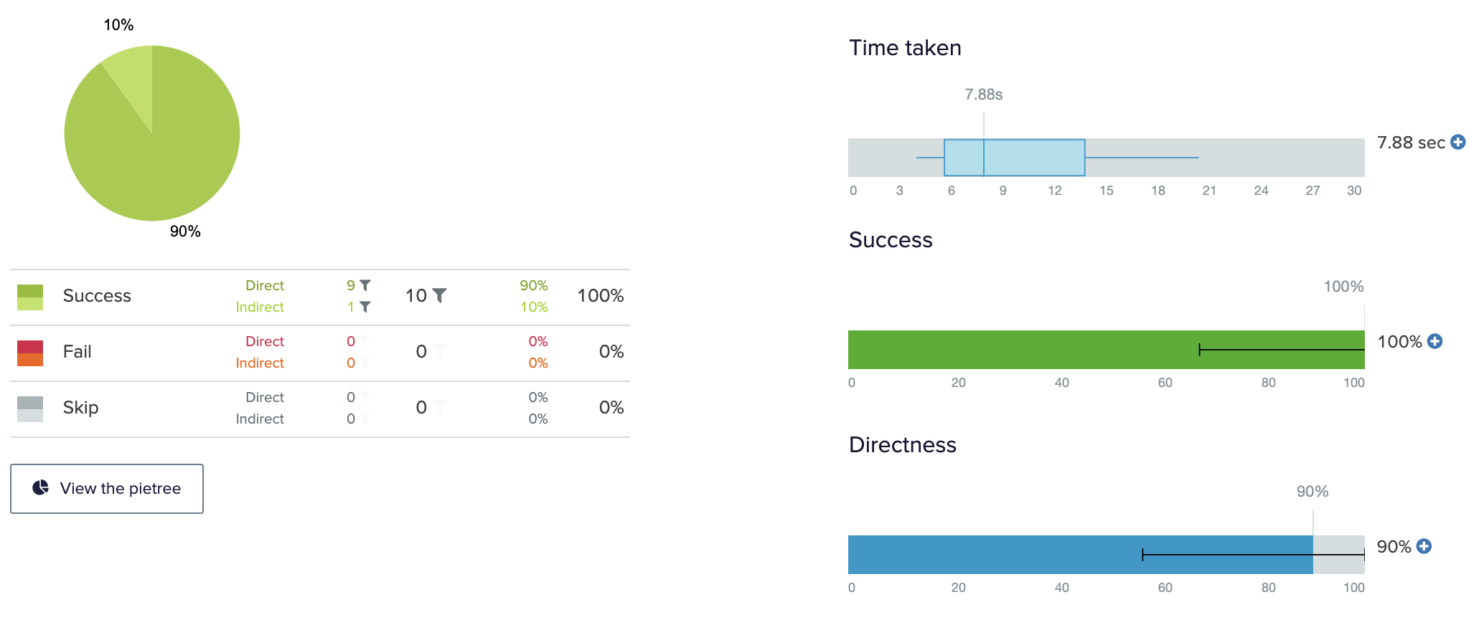
3. You want to apply a library card

Slide 12
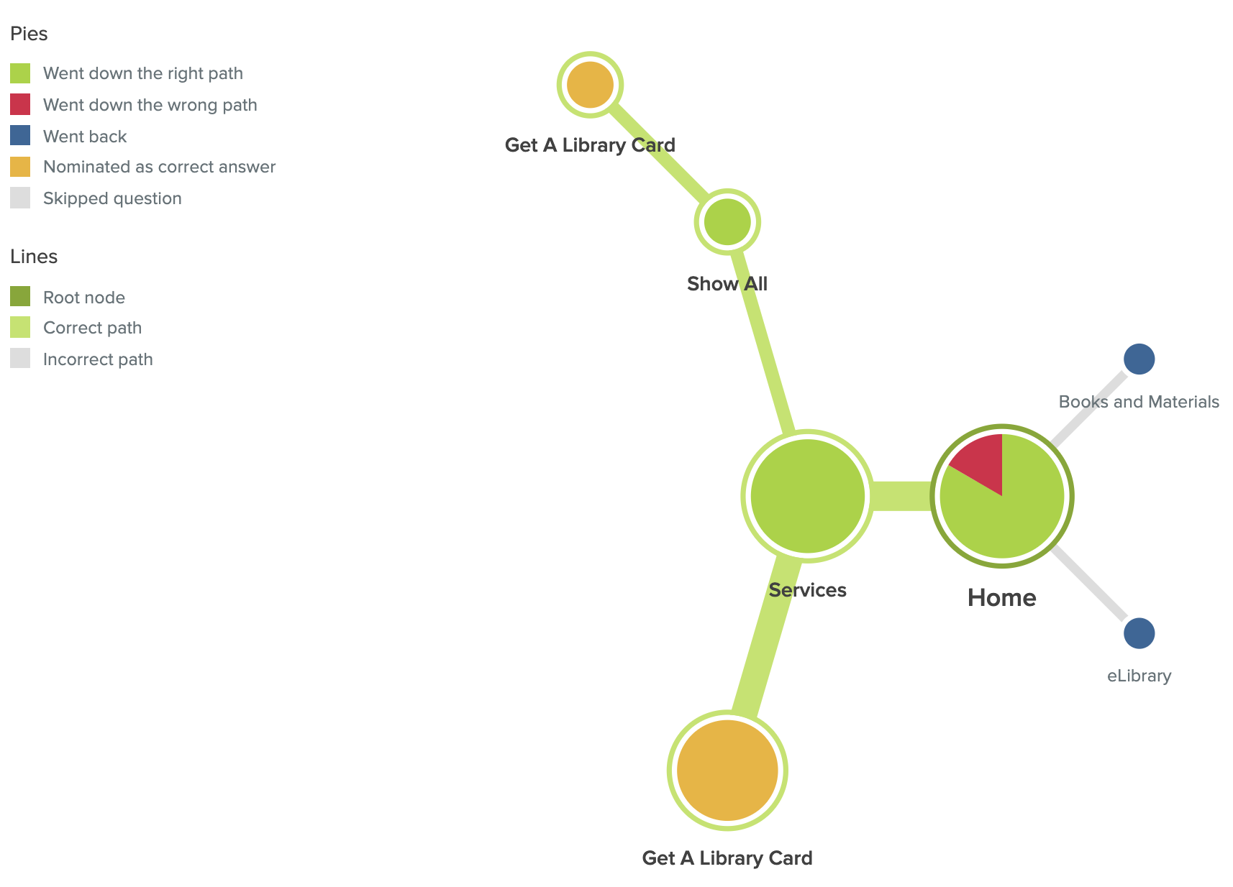
3. You want to apply a library card

Slide 13
3. You want to apply a library card
Potential pain points:
Few people will go the check eLibrary and books first.

Slide 14
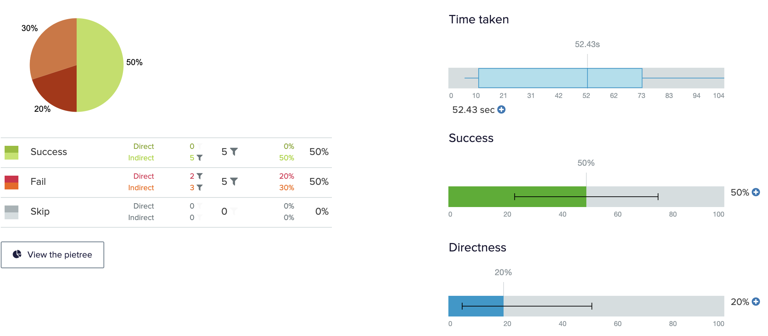
4.You want to ask for an online 1on 1 homework help

Slide 15
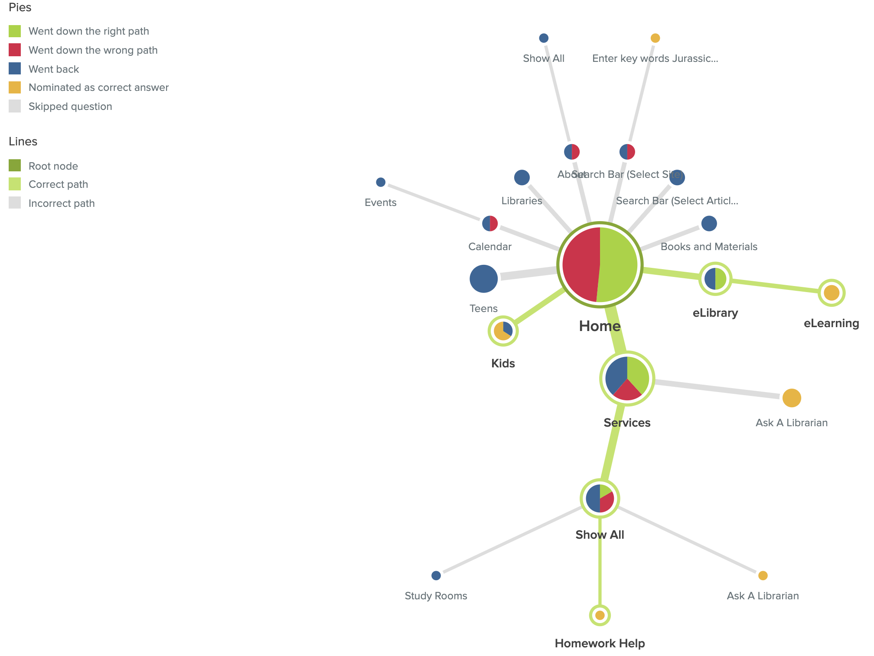
4.You want to ask for an online 1on 1 homework help

Slide 16
4.You want to ask for an online 1on 1 homework help
Potential pain points:
Some people choose to ask a librarian first.

Slide 17
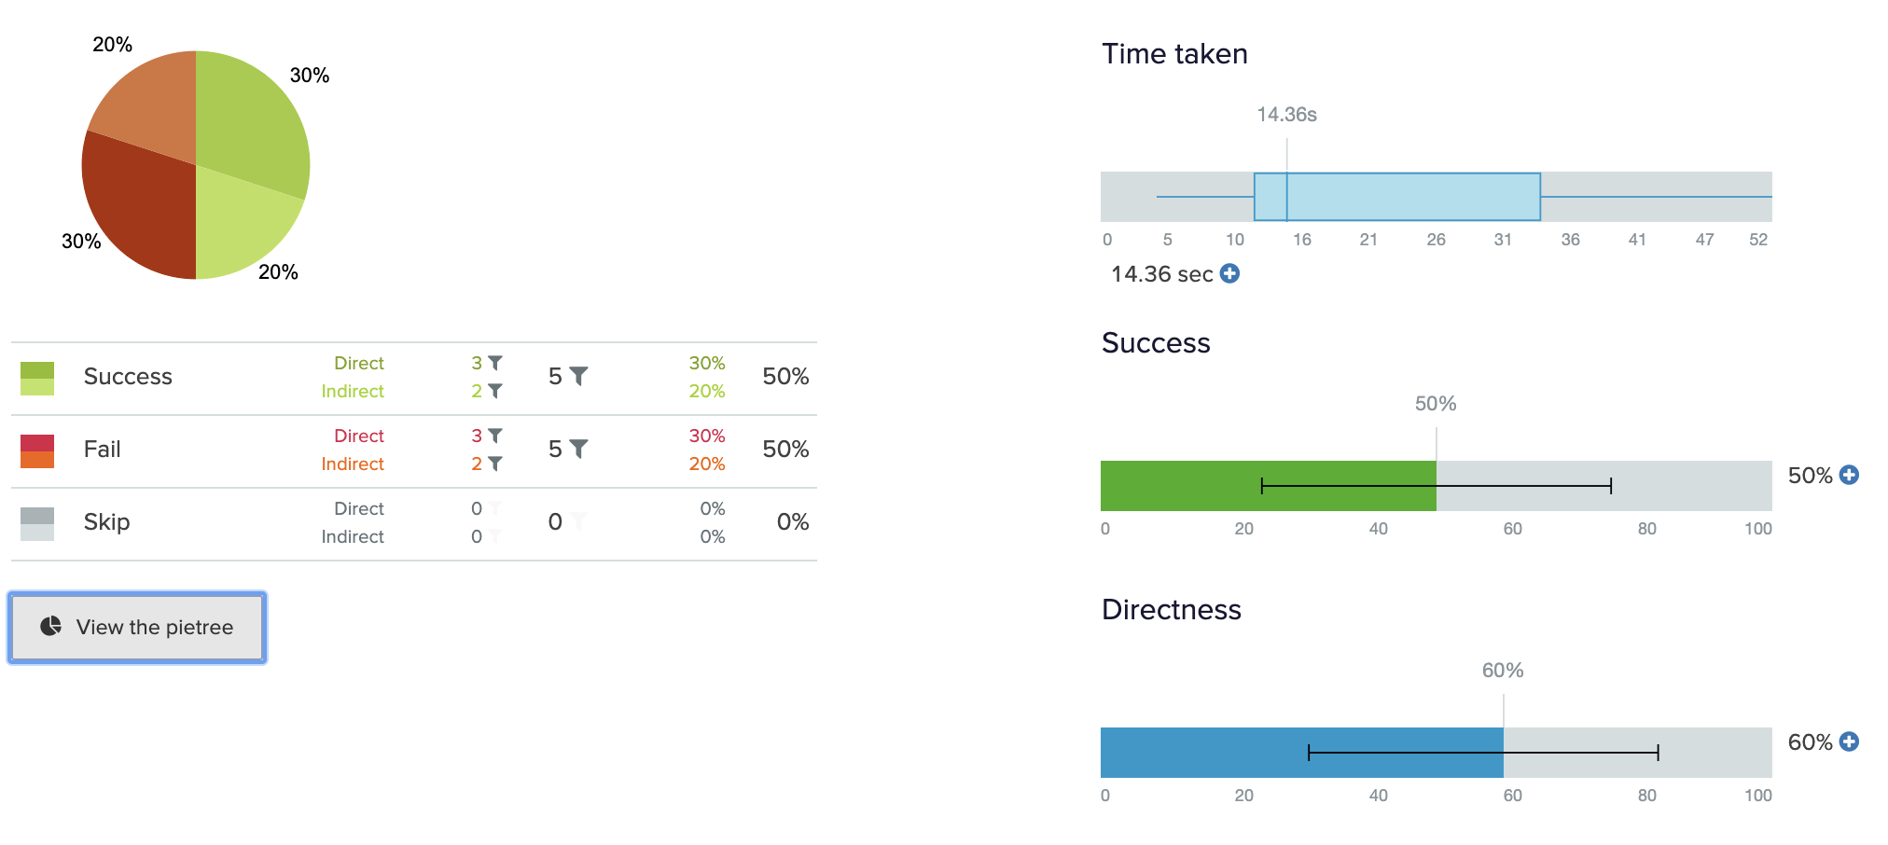
5. You want to check new arrived books

Slide 18
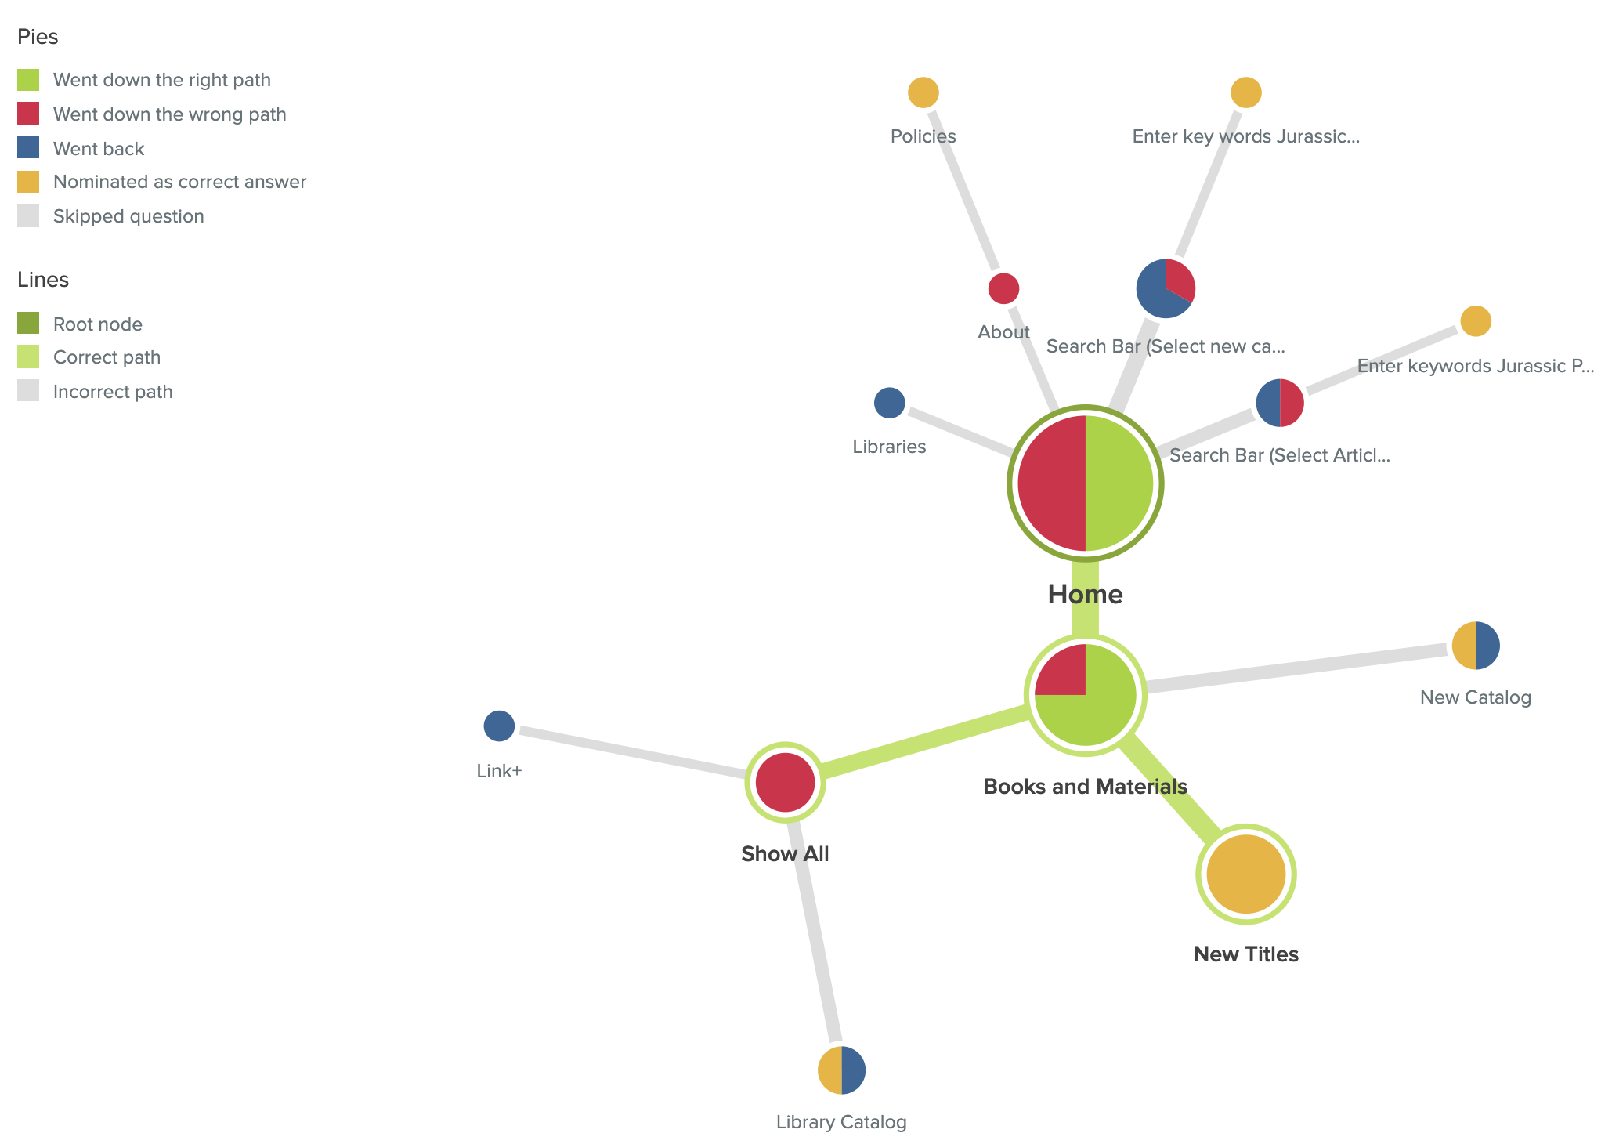
5. You want to check new arrived books

Slide 19
5. You want to check new arrived books
Potential pain points:
Some people choose catalog, but that’s not direct path.
Some people will confuse the libraries tag.

Slide 20
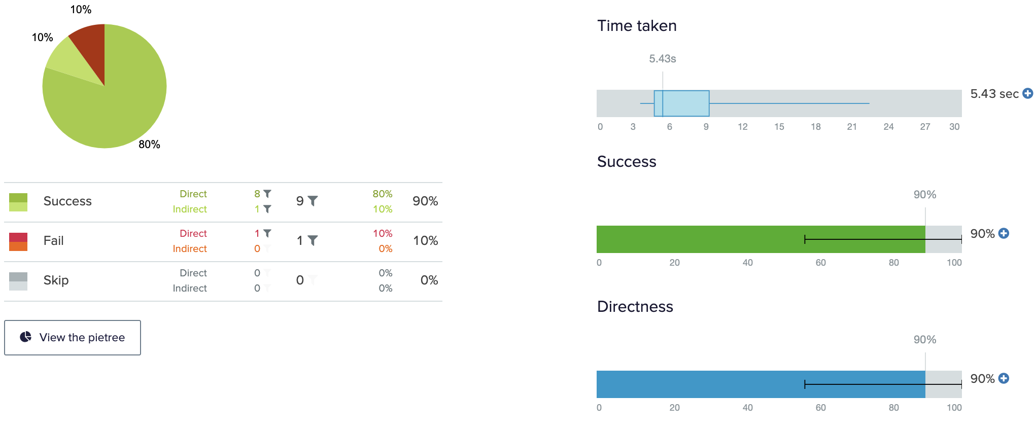
6. You want to find some interesting events held on the weekend

Slide 21
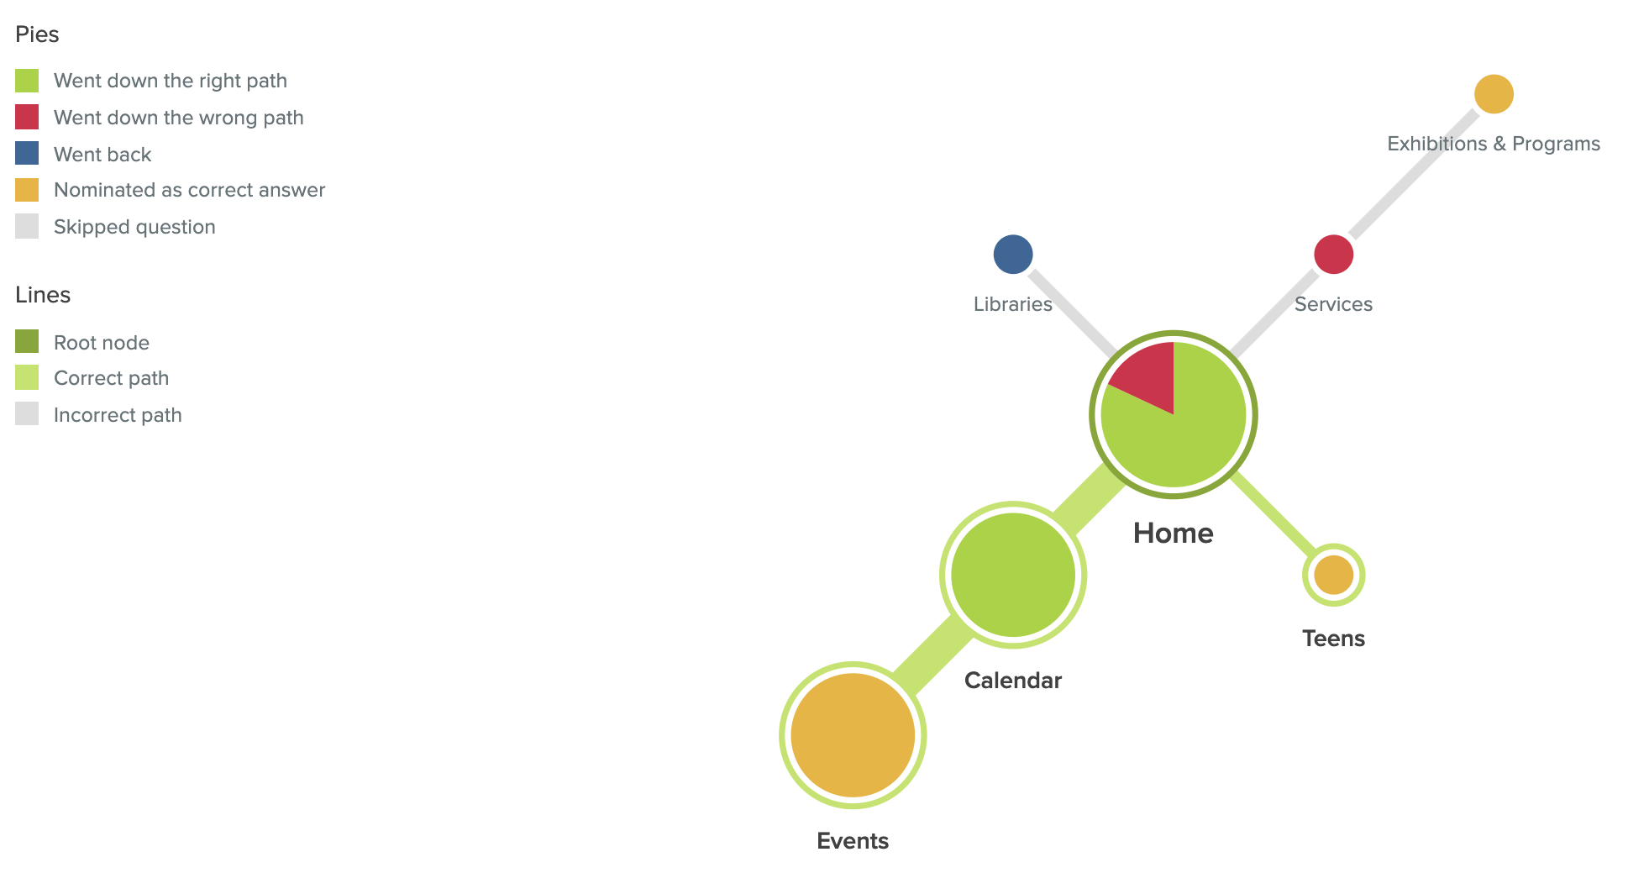
6. You want to find some interesting events held on the weekend

Slide 22
6. You want to find some interesting events held on the weekend
Potential pain points:
Some people will go to service> exhibition & program page, but actually there are only some descriptions there.

Slide 23
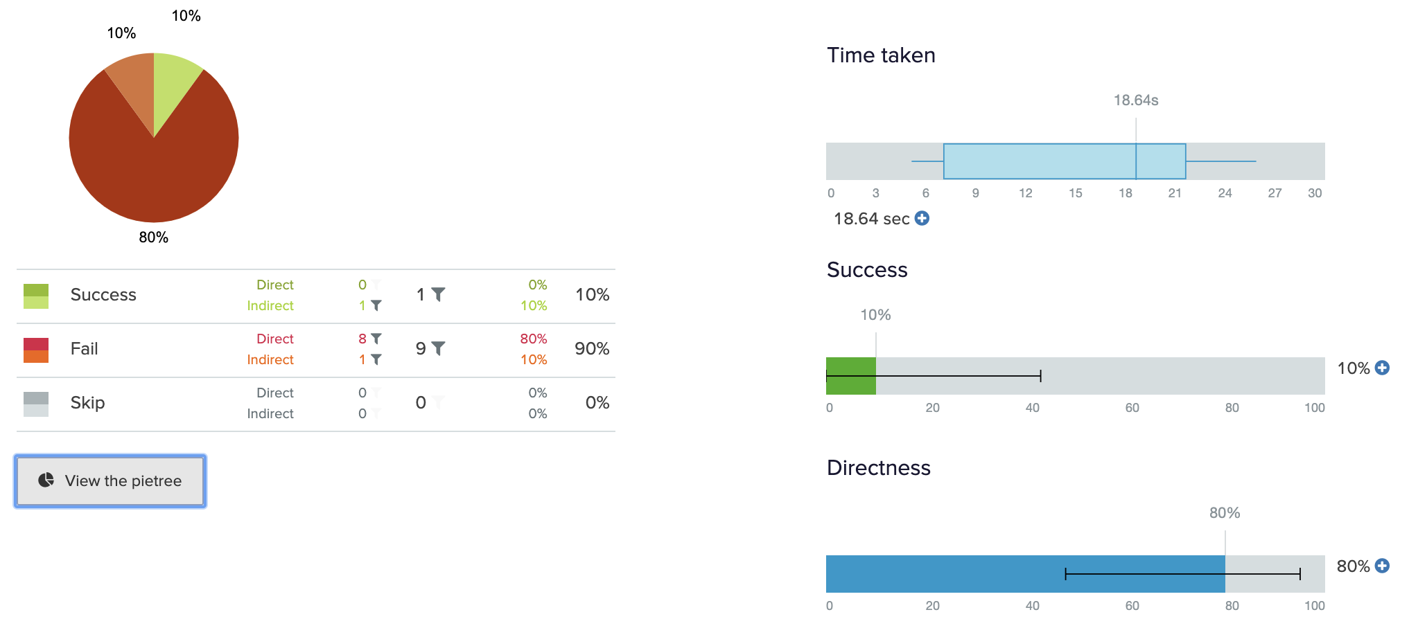
7.You want to borrow a laptop from a library

Slide 24
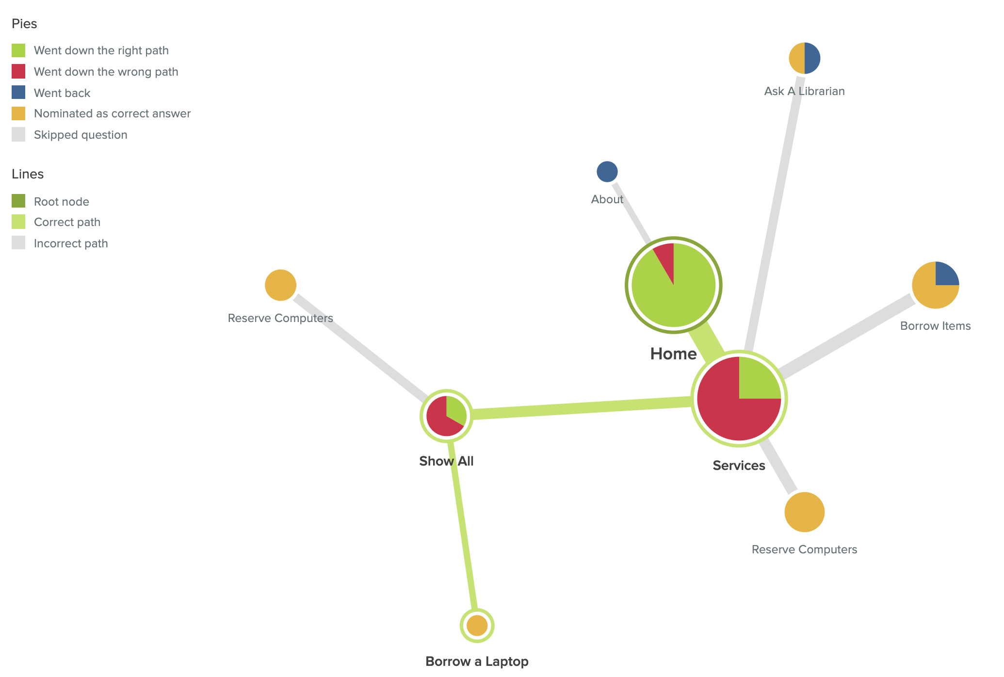
7.You want to borrow a laptop from a library

Slide 25
7.You want to borrow a laptop from a library
Potential pain points:
Some people will go to borrow items page, but actually there are only about FAQs about borrowing books or materials.

Slide 26
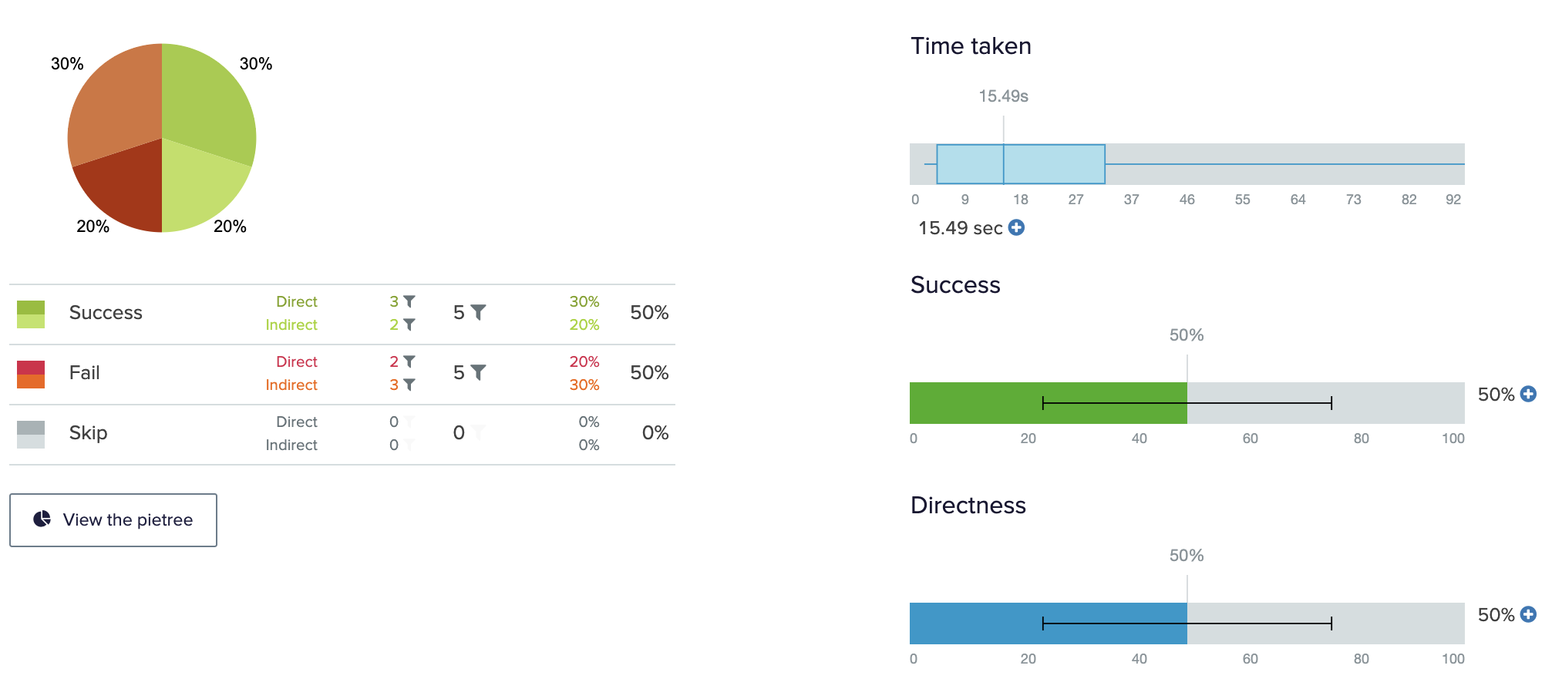
8. You want to enroll an online high school program

Slide 27
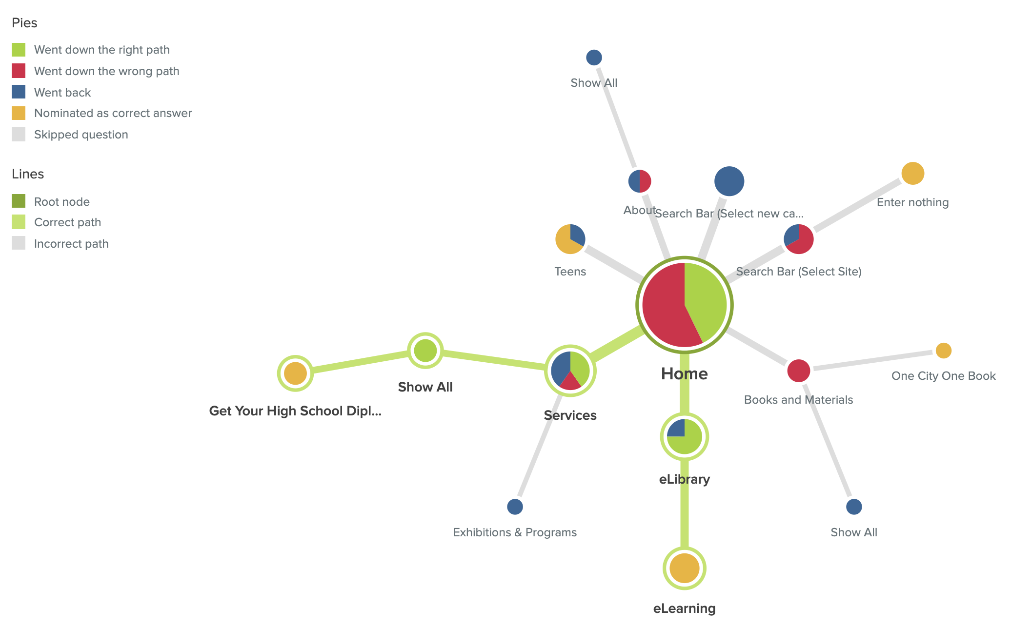
8. You want to enroll an online high school program

Slide 28
8. You want to enroll an online high school program
Potential pain points:
Some people will go to teens page, but there is no online high school program there.

Slide 29
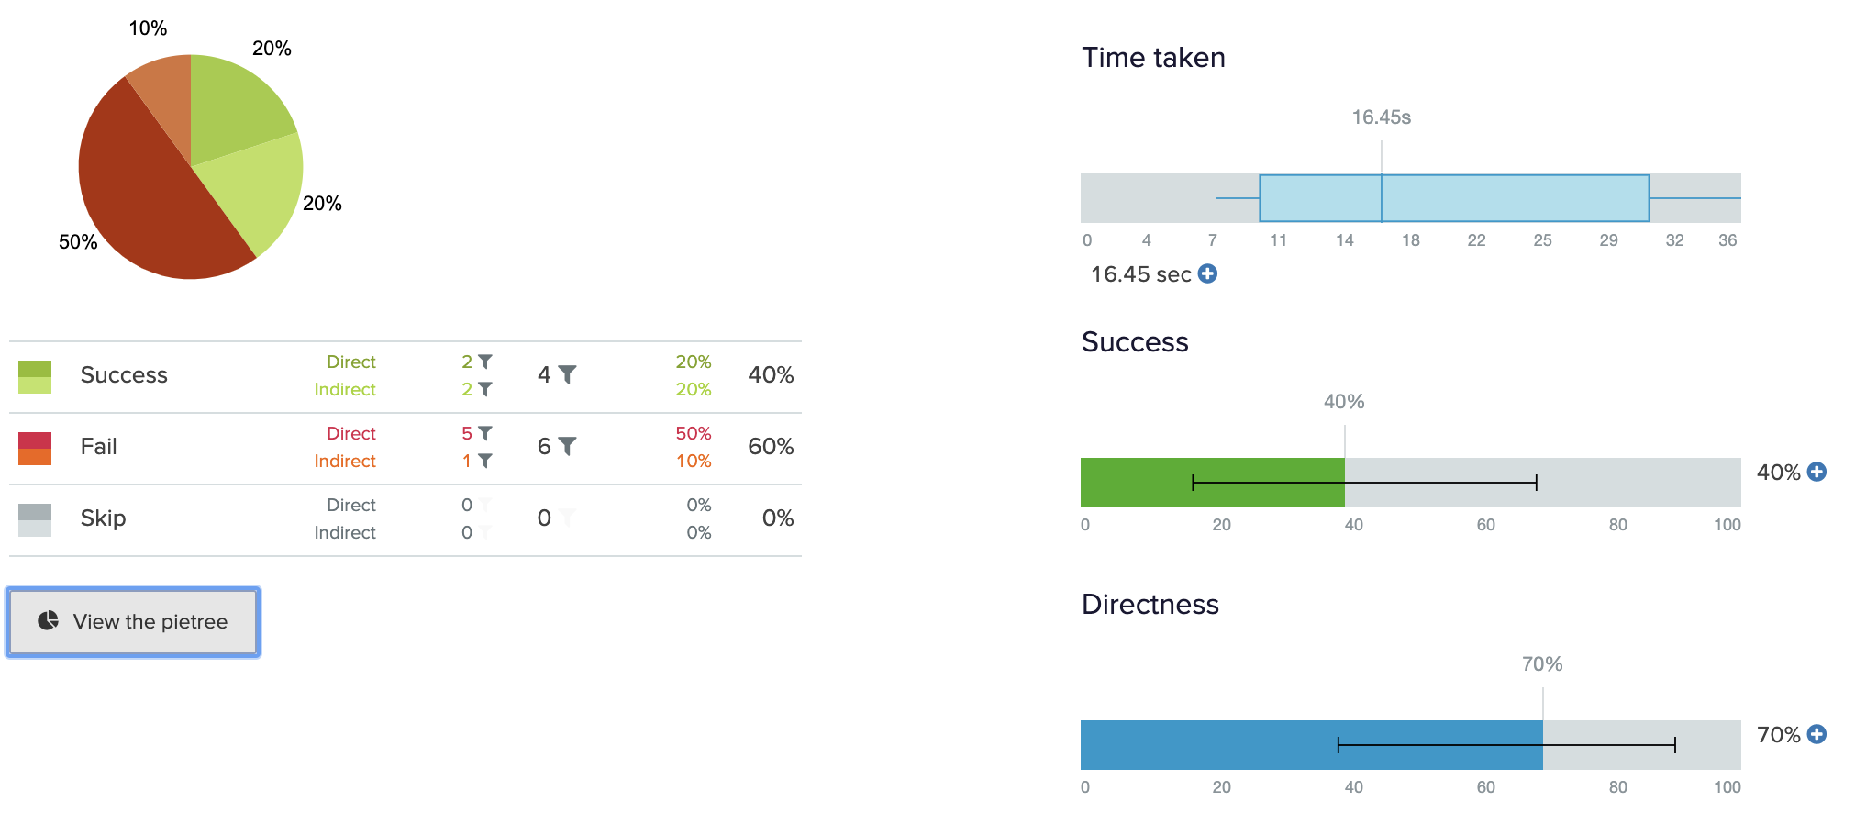
9. You want to check which library we can find a study room

Slide 30
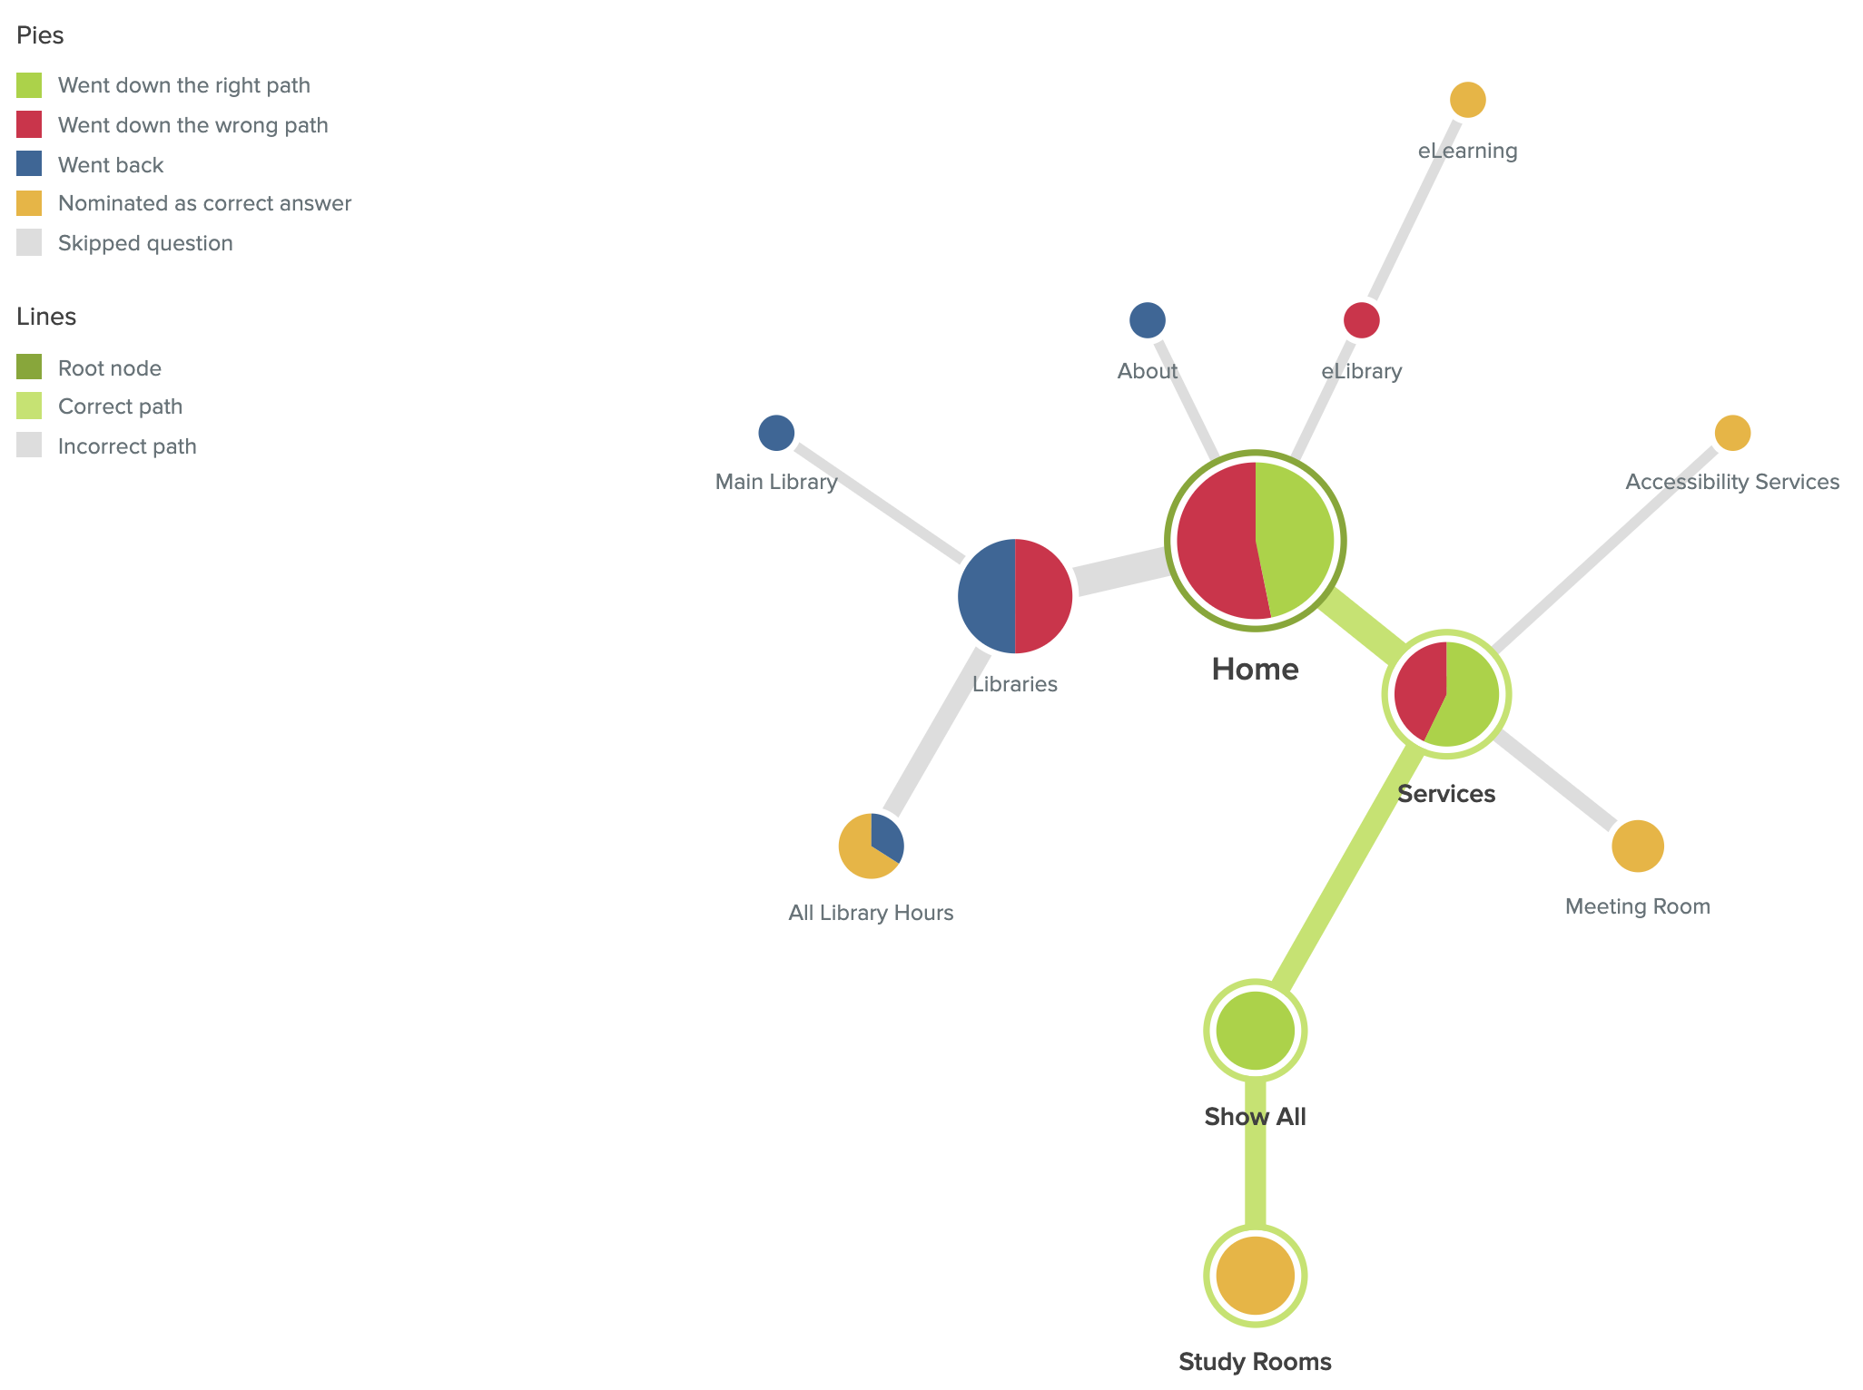
9. You want to check which library we can find a study room

Slide 31
9. You want to check which library we can find a study room
Potential pain points:
Some people will confuse meeting room and study room.

Slide 32
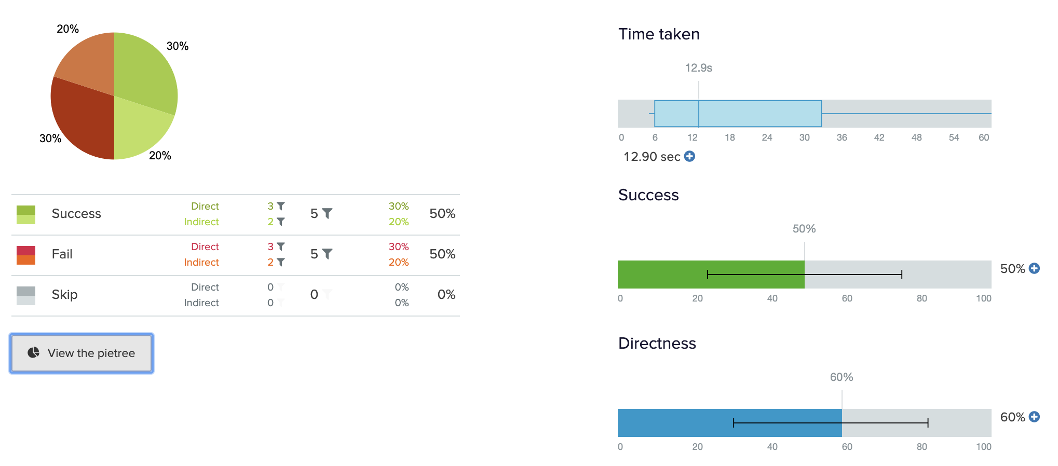
10. You want to find a job in a library

Slide 33
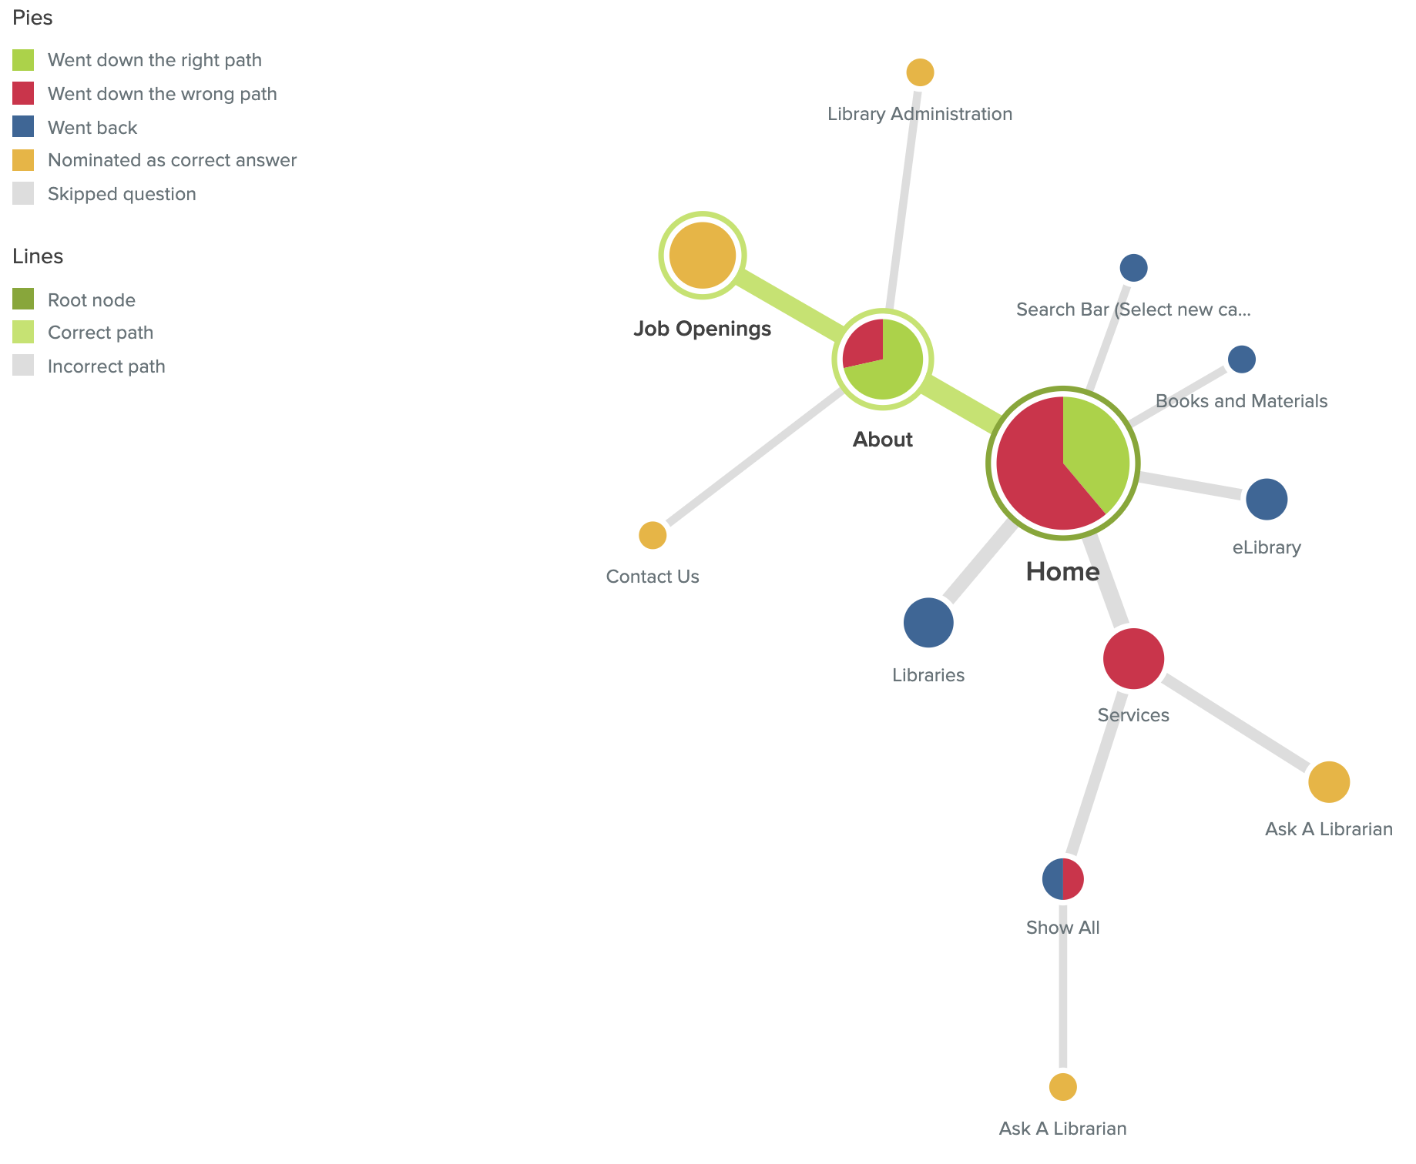
10. You want to find a job in a library

Slide 34
10. You want to find a job in a library
Potential pain points:
Some people will ask a librarian directly.

